Slide 1
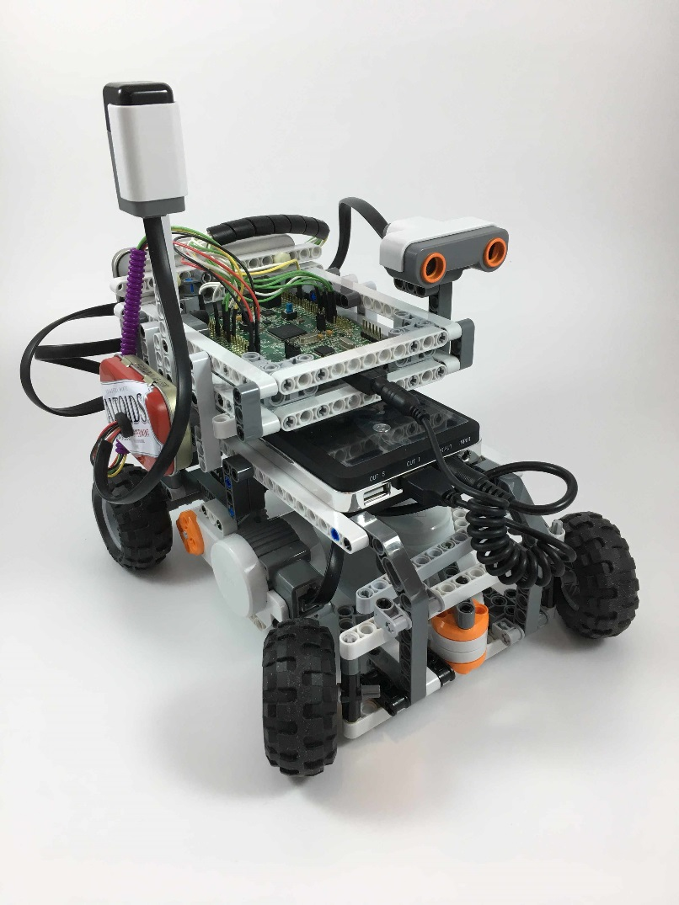
Connection/wiring diagrams for RC Car
The image at left shows the version using the IR Receiver.
We also have a version using Bluetooth instead.
Instructions for building the original car are here:
http://www.hitechnic.com/models
Note that we modified the car to hold an STM32 Discovery Kit
card that replaces the NXT Brick.
A video of their car is available on YouTube:
https://www.youtube.com/watch?v=KltnZBSvLu4

Slide 2
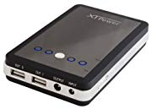
The Battery
XTPower MP-10000 External Battery Pack with 10000mAh using dual USB 5V and DC 9V / 12V 2A
Ideal because it provides the 9V for the motors and sonar sensor, and 5V for the computer.
(Can use 12V for the motors if desired.)

Slide 3
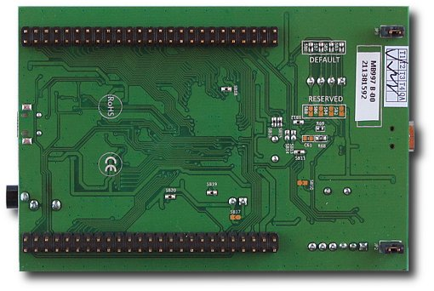
Modify the F4 Disco target board
You must disable the blue User button on the F4 Disco board so that the GPIO pin PA0 is available for use by the on-board app.
To do so, remove (de-solder) solder bridge SB20 described in UM1472 Discovery kit for STM32F407/417 lines document
See Table 4 “Solder bridges”
See Figure 16 for circuit

Slide 4
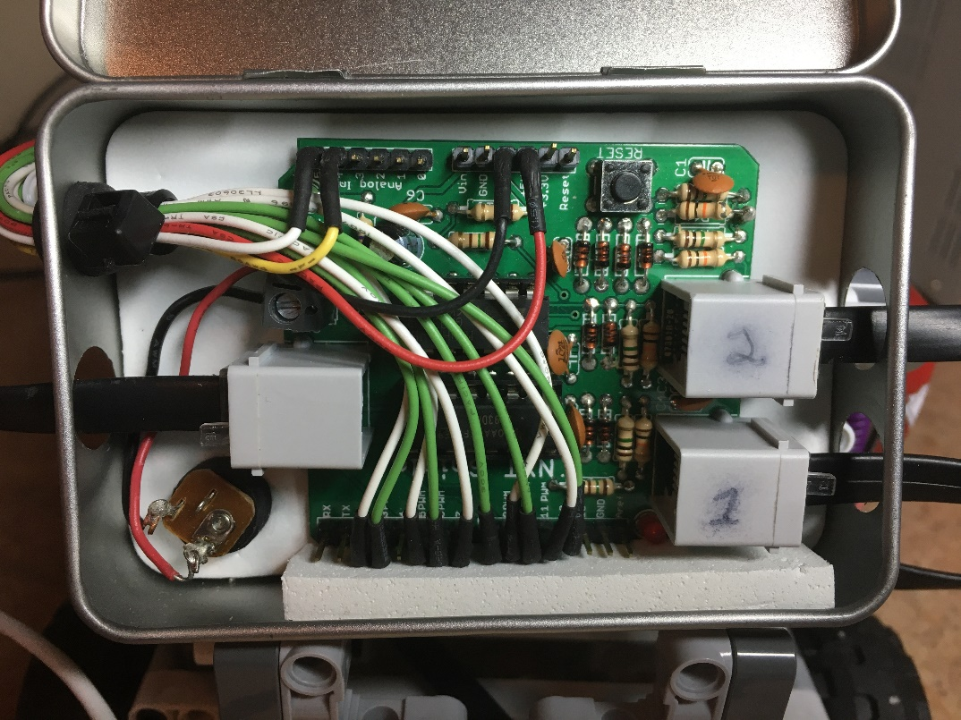
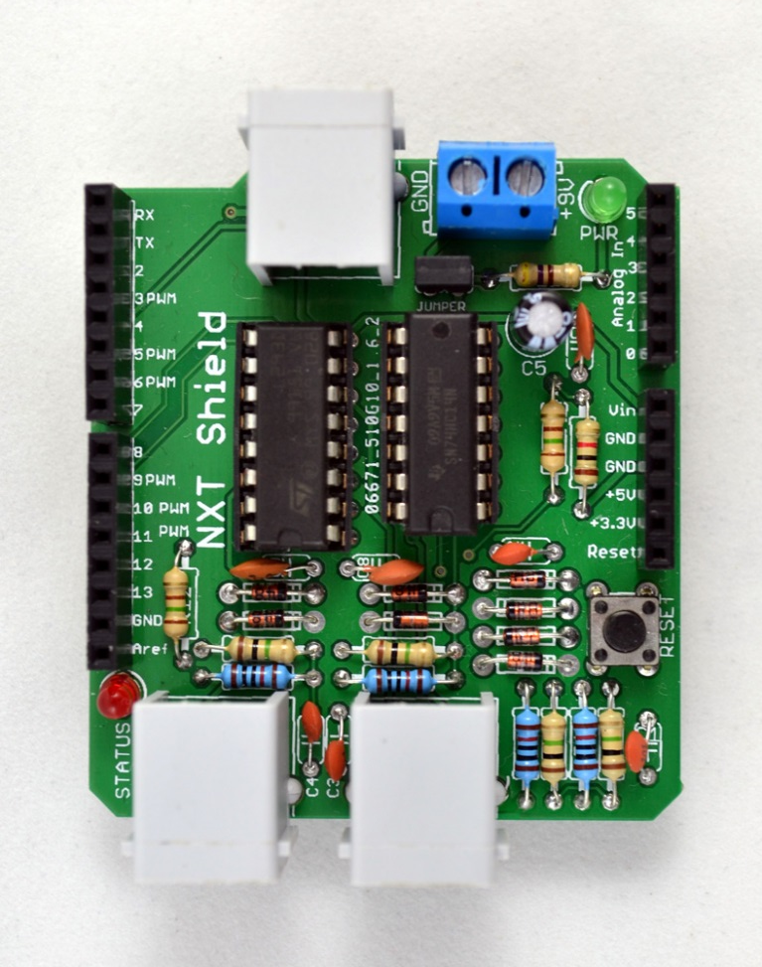
NXT Shield
Provides circuitry for the two motors and the sonar sensor
Kit, available for purchase from http://shop.tkjelectronics.dk/product_info.php?products_id=29
SONAR
M1
M2

Slide 5
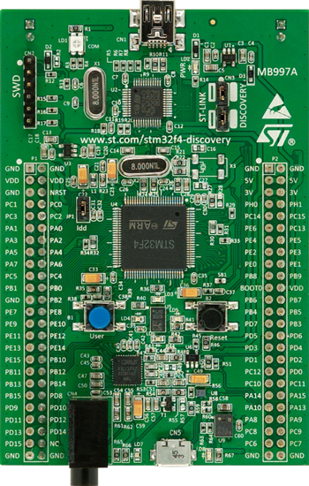
Power to NXT Shield
From battery
From battery
Gnd
9V
red and black
wires
Gnd
5V
M1
M2

Slide 6
Motor1
NXT2:PA15, Tach1
NXT5:PB3, Tach2
NXT7:PA10, Polarity1
NXT9:PB6, PWM
M1, Tach1
NXT11:PB1, Polarity2
M1, Tach2
M1, P1
white
wires
M1, PWM
M1, P2
M1
M2
PB1
PB6
PB3
Wire colors are not as used
PA15
PA10

Slide 7
Motor2
NXT3:PA0, Tach1 (requires removal of solder bridge SB20)
NXT6:PA1, Tach2
NXT12:PA2, Polarity1
NXT10:PB4, PWM
NXT8:PA3, Polarity2
M2, Tach1
M2, Tach2
green
wires
M2, P2
M2, PWM
M2, P1
PA1
PA0
PA3
PA2
M1
M2
PB4
Wire colors are not as used

Slide 8
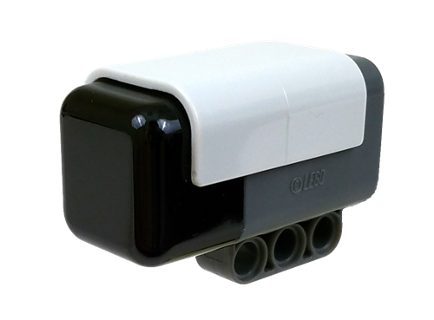
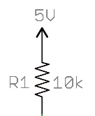
HiTechnic IR Receiver
Vin: 5V
Wire colors are not as used
Gnd: Gnd
SDA: PB9
SCL: PB8
Using I2C #1
Altoids container
Gnd
Vin
Gnd
5v
SDA
PB9
PB8
SCL
Resistors are in the Altoids can.
Power and ground lines go to the Altoids can, then from there to the sensor.
The sensor lines go into the Altoids can.

Slide 9
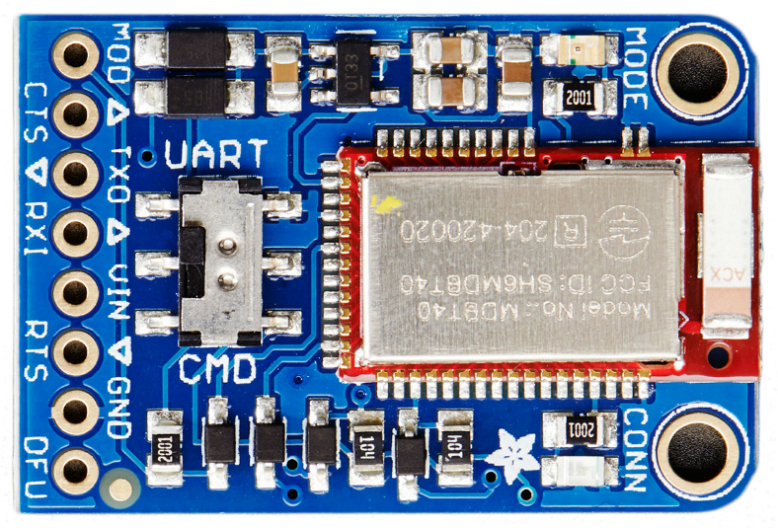
Bluefruit LE Friend UART
Vin: 5V
Gnd: Gnd
MOD : PD0;
CTS : PD3;
RTS : PD4;
Tx : PD5; -- RXI pin on breakout board
Rx : PD6; -- TXO pin on breakout board
Wire colors are not as used
On USART #2
Gnd
MOD
5v
CTS
TXO
RXI
Vin
RTS
PD6
Gnd
PD5
PD4
PD3
PD0
DFU is not connected

Slide 10
Bluefruit LE Friend SPI
Vin: 5V
Gnd: Gnd
SDA: PB
SCL: PB
Wire colors are not as used
Vin
Gnd
5v
Gnd
SDA
SCL
RST
PB5
PB10
PB11

Slide 11
Ultrasonic
Sensor
SCL
PB13
A5
A4
PB11
SDA
M1
M2
This is for a 9-volt sensor,
not an A/D sensor

